Slide 1
CS2040S Tutorial 2
Done by Xiao Yan

Slide 2
Tutorial Time

Slide 3
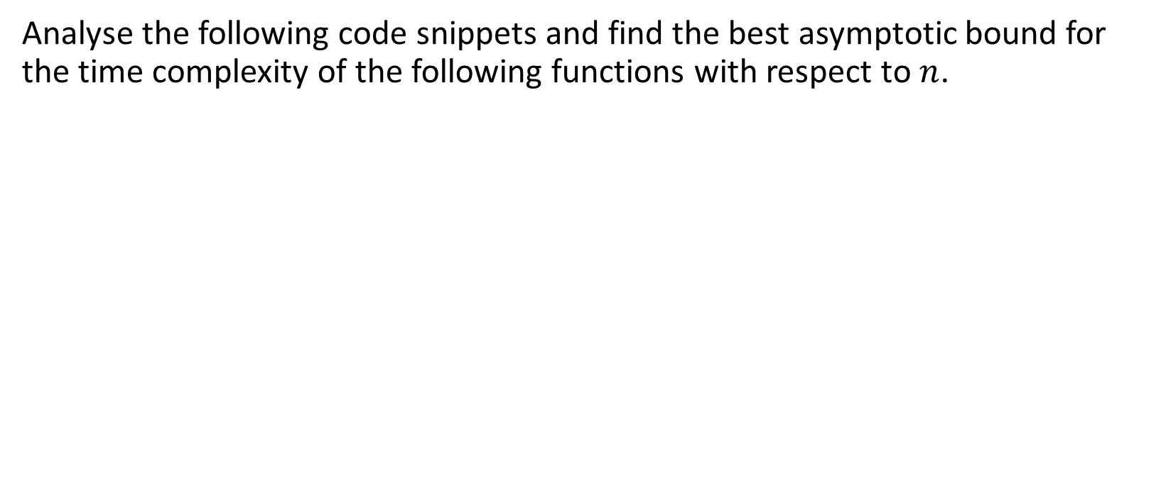
Problem 1: Time Complexity Analysis

Slide 4
P1(a)
public int niceFunction(int n) { for (int i = 0; i < n; i++) { System.out.println(“I am nice!”); } return 42; }

Slide 5
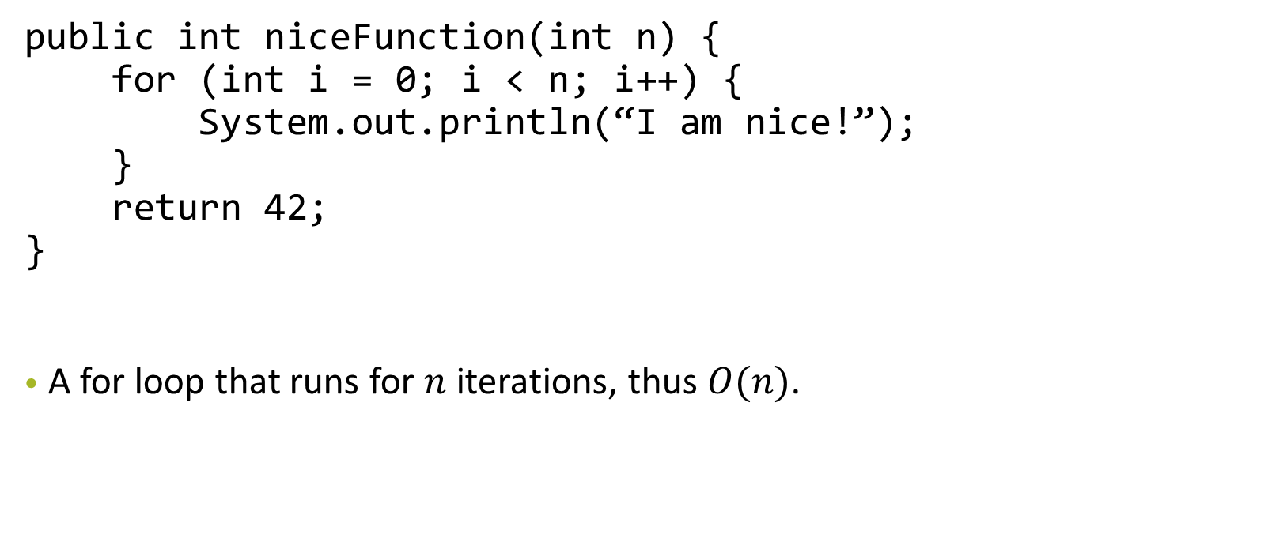
P1(a)

Slide 6
P1(b)
public int meanFunction(int n) { if (n == 0) return 0; return 2 * meanFunction(n / 2) + niceFunction(n); }

Slide 7
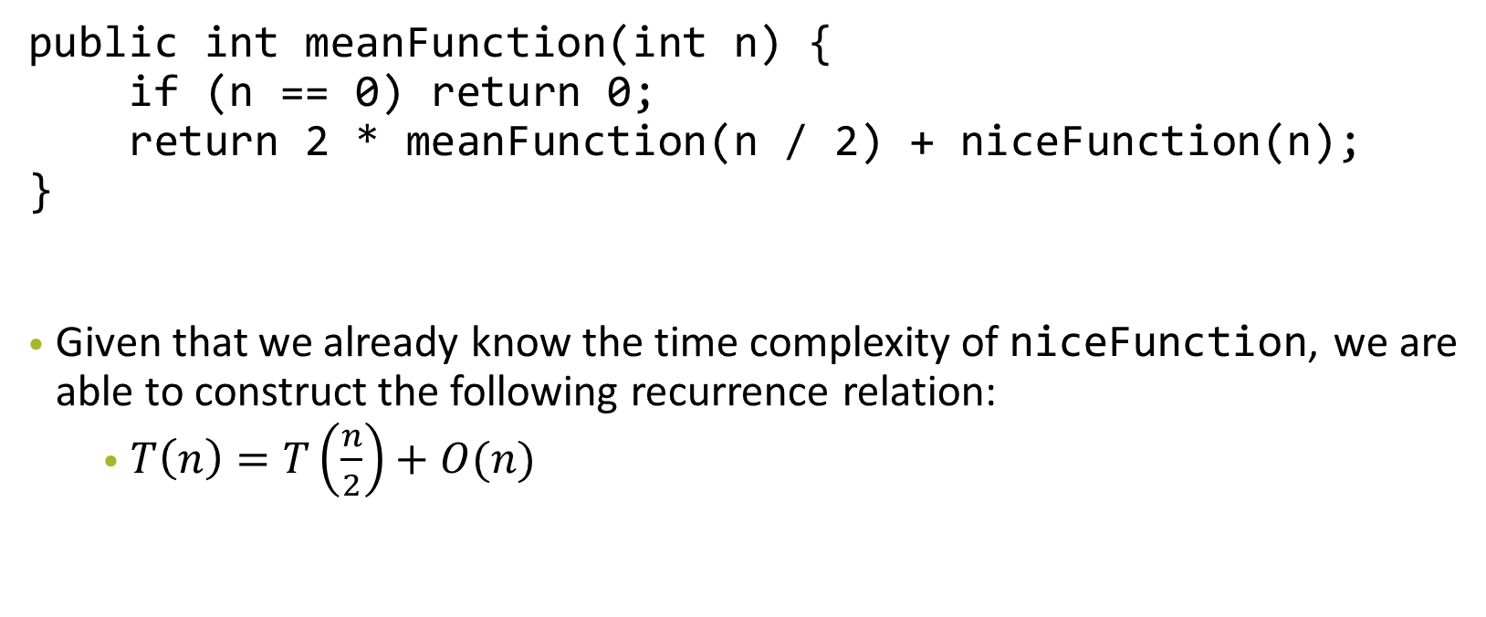
P1(b)

Slide 8
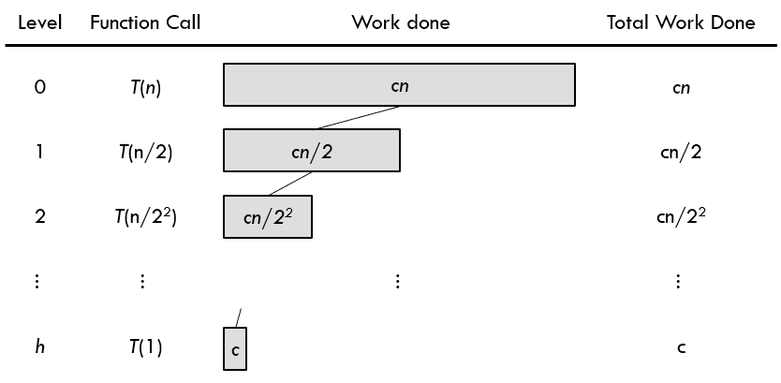
P1(b)
We can then solve the recurrence relation by drawing the recurrence tree:

Slide 9
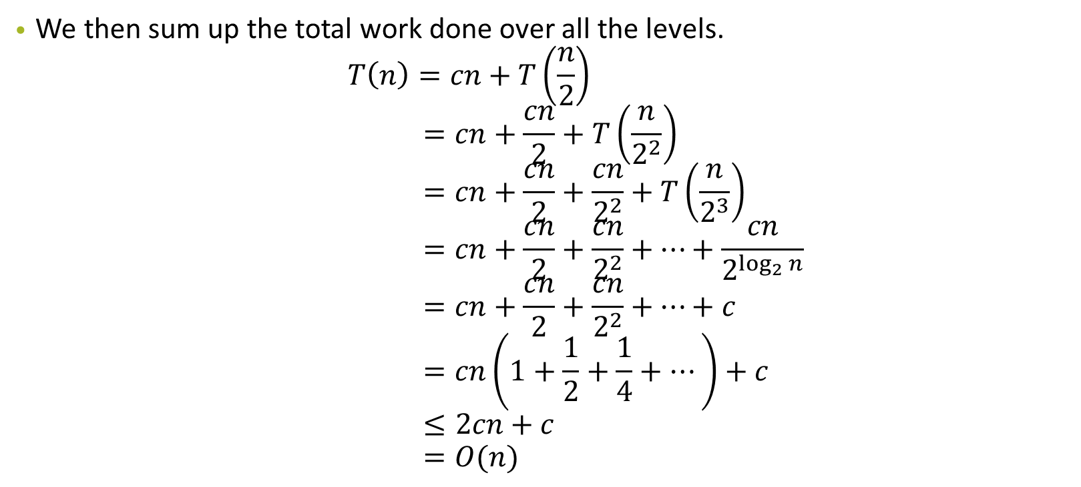
P1(b)

Slide 10
P1(c)
public int strangerFunction(int n) { for (int i = 0; i < n; i++) { for (int j = 0; j < i; j++) { System.out.println(“Execute order?”); } } return 66; }

Slide 11
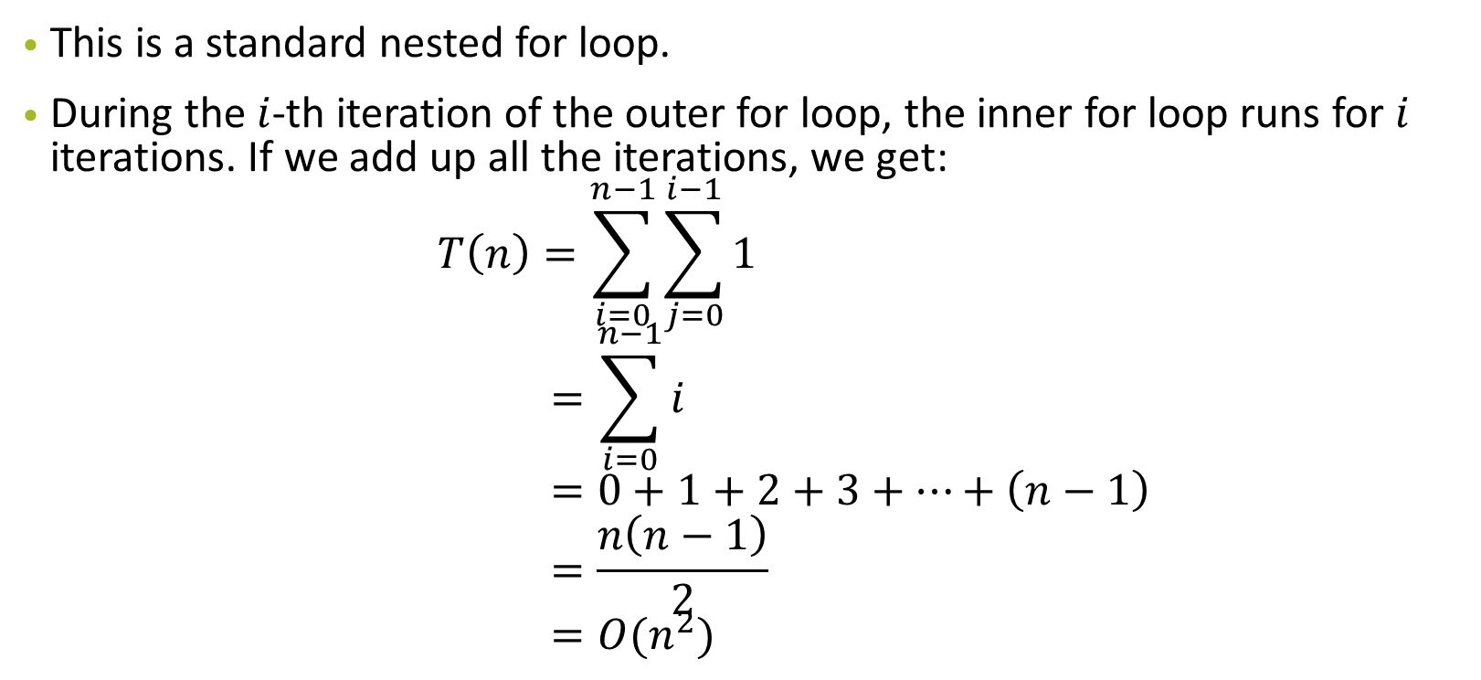
P1(c)

Slide 12
P1(d)
public int suspiciousFunction(int n) { if (n == 0) return 2040; int a = suspiciousFunction(n / 2); int b = suspiciousFunction(n / 2); return a + b + niceFunction(n); }

Slide 13
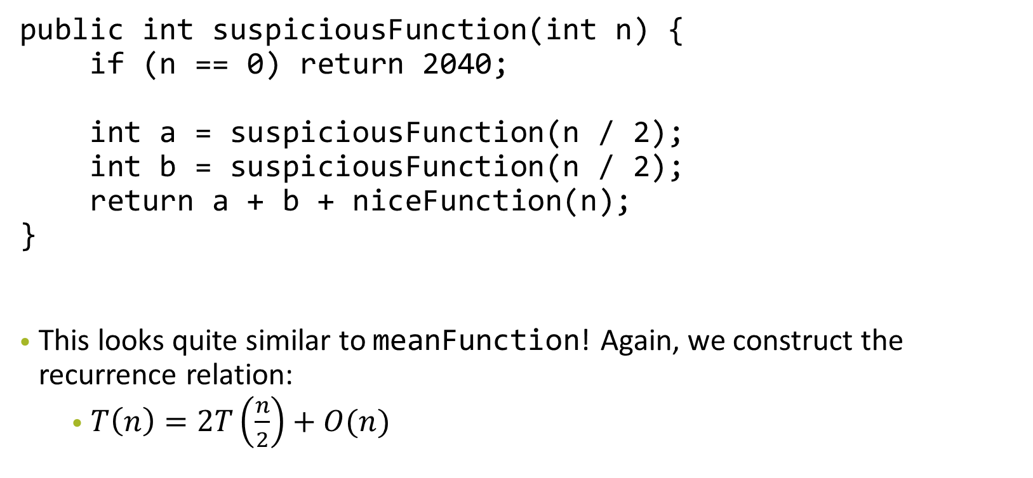
P1(d)

Slide 14
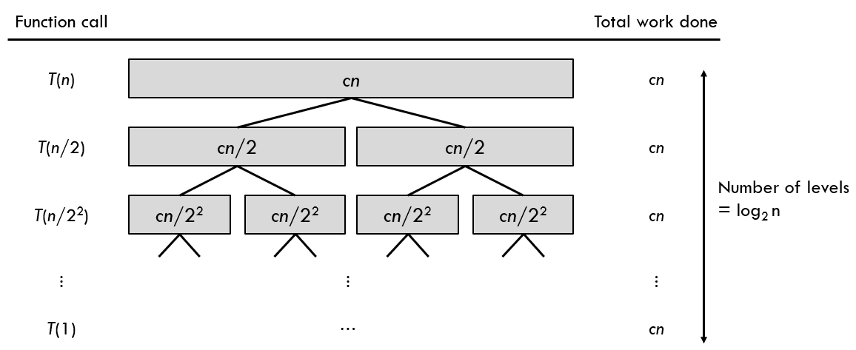
P1(d)
We can then solve the recurrence relation by drawing the recurrence tree:

Slide 15
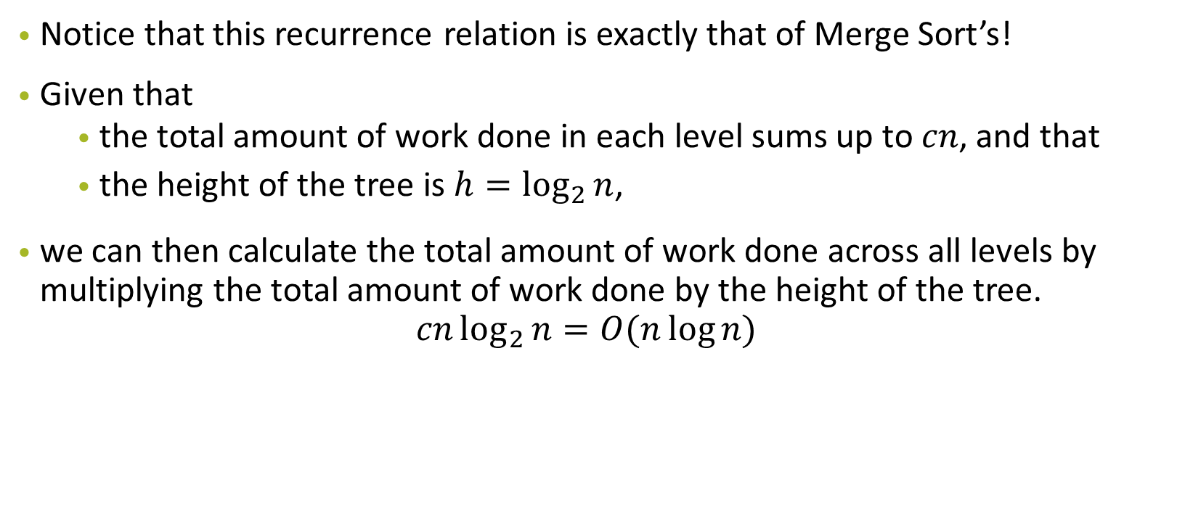
P1(d)

Slide 16
P1(e)
public int badFunction(int n) { if (n <= 0) return 2040; if (n == 1) return 2040; return badFunction(n – 1) + badFunction(n – 2) + 0; }

Slide 17

P1(e)

Slide 18
P1(f)
public int metalGearFunction(int n) { for (int i = 0; i < n; i++) { for (int j = 1; j < i; j *= 2) { System.out.println(“!”); } } }

Slide 19
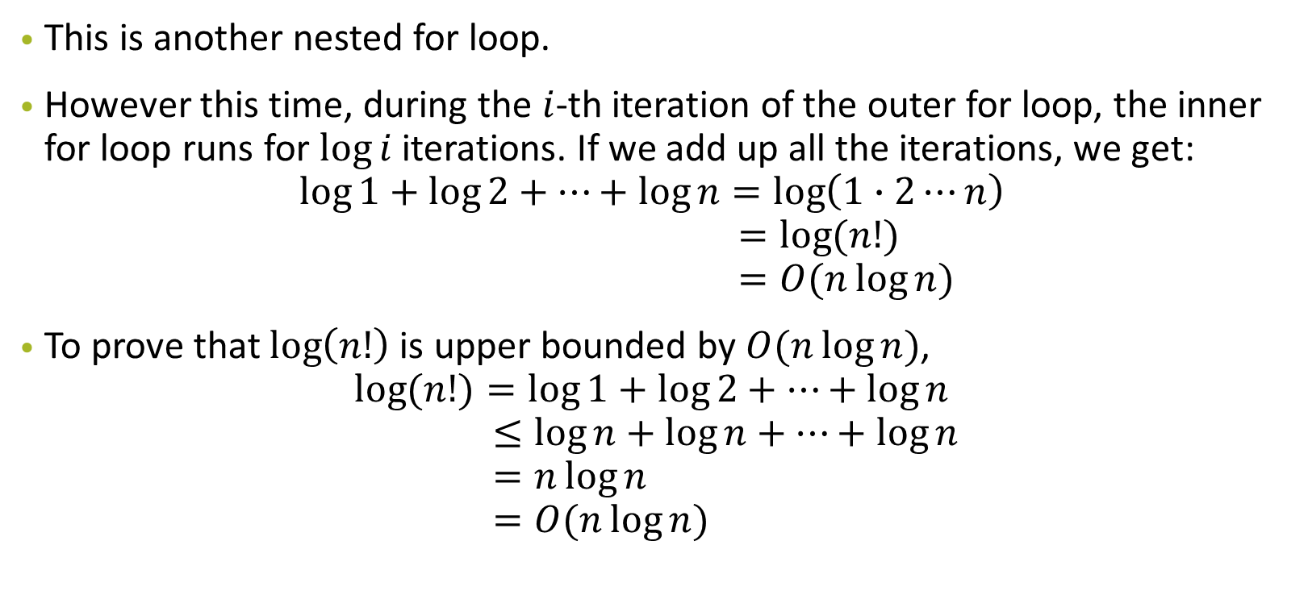
P1(f)

Slide 20
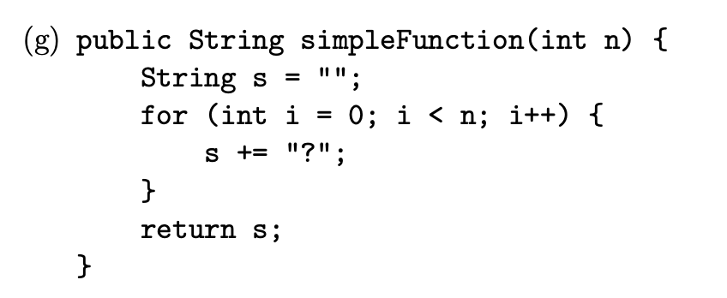
P1(g)

Slide 21

P1(g)

Slide 22
P1(g)
Java string concatenation: O(n), n = length of string
On each concatenation, a new copy is created

Slide 23
P1(g)
Java string concatenation: O(n), n = length of string
On each concatenation, a new copy is created
i-th iteration — i - 1 long

Slide 24
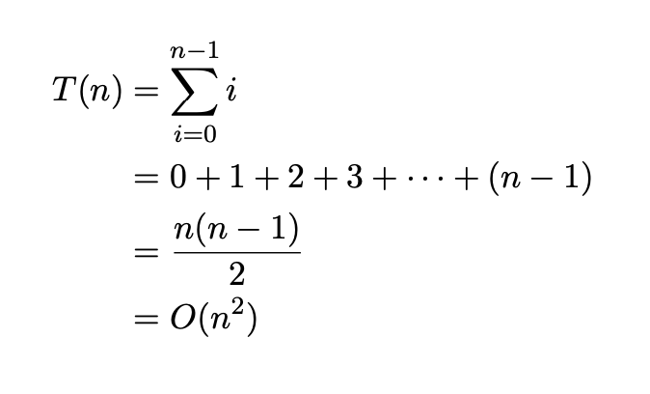
P1(g)
Java string concatenation: O(n), n = length of string
On each concatenation, a new copy is created
i-th iteration — i - 1 long

Slide 25
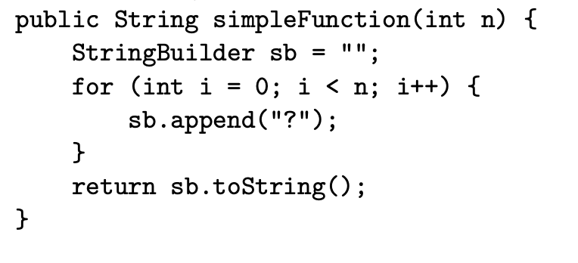
Better way to do string concatenation?
StringBuilder !
O(1) append

Slide 26
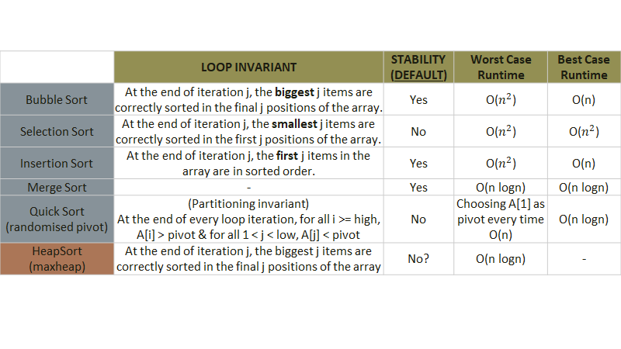

Slide 27
Qn2(a)
How would you implement insertion sort recursively?
Analyse the time complexity by formulating a recurrence relation.

Slide 28
Qn2(a) (Answer)
Recursively sort the array from index 0 to (n - 1). Then, insert the last element
into the sorted subarray. The recurrence relation will be
T(n) = T(n - 1) + O(n)
Solving it results in the time complexity O(n²).

Slide 29
Qn2(b)
Consider an array of pairs (a,b). Your goal is to sort them by a in ascending order first, and then by b in ascending order.
Do you Merge sort first or Selection Sort

Slide 30
Qn2(b) (Answer)
Consider the stability of each sort.
MergeSort -> Stable
SelectionSort -> Not stable
SelectionSort b first, then MergeSort by a
Eg. (1,3), (1,4), (2,1)...

Slide 31
Qn2(c)
We have learned how to implement MergeSort recursively. How would you implement Merge-Sort iteratively? Analyse the time and space complexity.

Slide 32
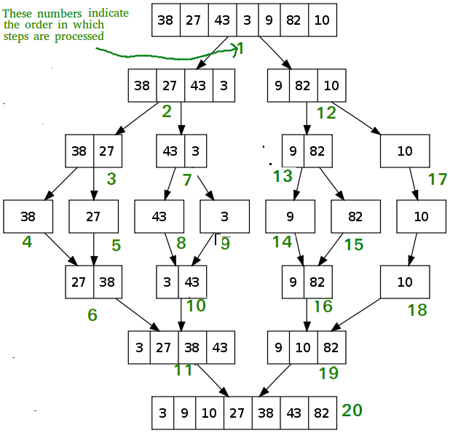
Qn2 (c) (Answer)
Do it bottom up!
Increment sorting by power of 2
1st iteration = 2 (sort in pairs)
2nd iteration = 4 (sort in 4s)
...
Nth iteration = (2^n)
Time: O(nlogn)
Space: O(n) as u use an auxiliary
array

Slide 33
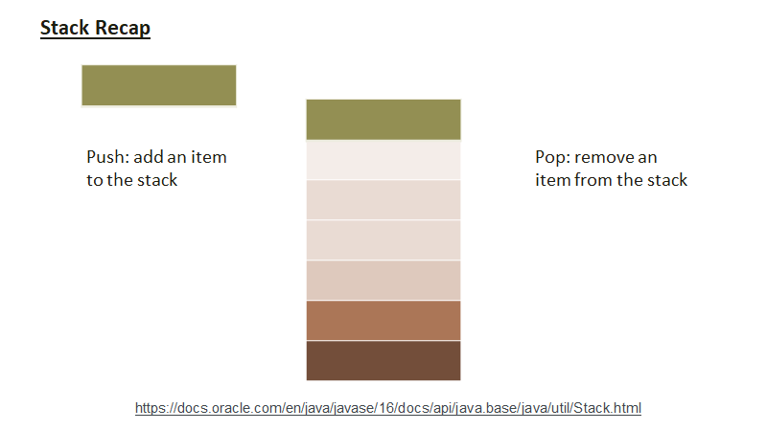

Slide 34
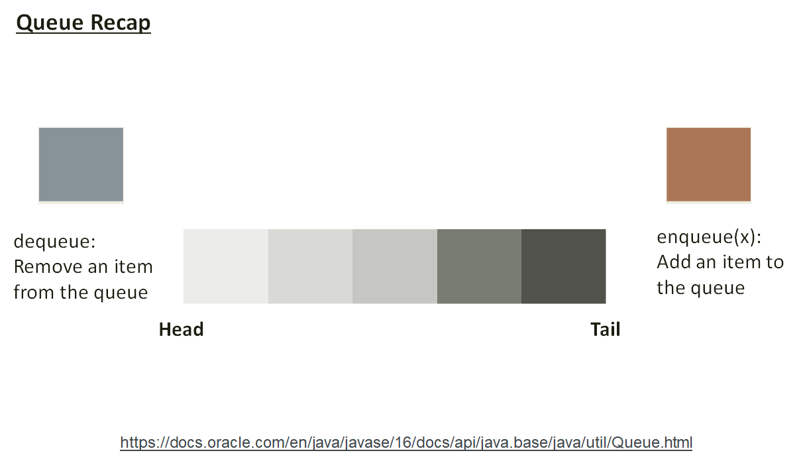

Slide 35
Qn3 a)
How would you implement a stack and queue with a fixed-size array in Java? (Assume that the number of items in the collections never exceed the array's capacity.)

Slide 36
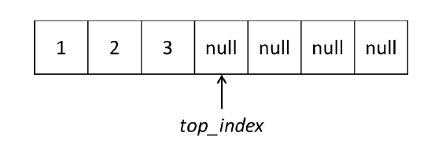
Qn3 a)
Stack: Maintain an index at the top of the stack.
On Push, set element to the arr[index] , index + 1
On pop, return the value at arr[index], set arr[index] = null, index -1

Slide 37
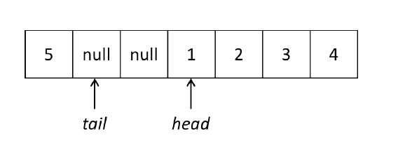
Qn3 a)
Queue: Maintain an head and tail index on the array.
On enqueue, set element to the arr[tailIdx] , tailIdx++
On dequeue, return value at arr[headIdx] , set arr[headIdx] = null, headIdx++
When it is head/tail index is at the end, wrap back around into the array (by mod length)

Slide 38
Qn3 b)
A Deque (double-ended queue) is an extension of a queue, which allows en-queueing and dequeuing from both ends of the queue. So the operations it would support are enqueue front, dequeue front, enqueue back, dequeue back. How can we implement a Deque with a fixed-size array in Java? (Again, assume that the number of items in the collections never exceed the array's capacity.)

Slide 39
Qn3 b) Answer
Same as before,
front ops will manipulate front index, but back ops will manipulate tail index.

Slide 40
Qn3 c)
What sorts of error handling would we need, and how can we best handle these situations?

Slide 41
Qn3 c) Answer
For add operations enqueue/push -> check for capacity limit, if the stack/ queue size > given.
For removed operations dequeue/pop, check we are not removing from an empty collection(in this case array).

Slide 42
Qn3 d)
A set of parentheses is said to be balanced as long as every opening parenthesis “(” is closed by a closing parenthesis “)”. So for example, the strings “()()” and “(())” are balanced but the strings “)(())(” and “((” are not. Using a stack, determine whether a string of parentheses are balanced.

Slide 43
Qn3 d) Answer
Use a stack!
When open bracket is used -> push to stack
When closed bracket is used -> pop from stack
The string will be valid if stack is empty at the end + there are no pops on empty stack.

Slide 44
Qn3 d) Extension
What if we have multiple types of parentheses like {}, []? How would our approach be different?

Slide 45
Qn3 d) Extension Answer
Same as before!
But new equality check between new parenthese and the popped parenthese

Slide 46
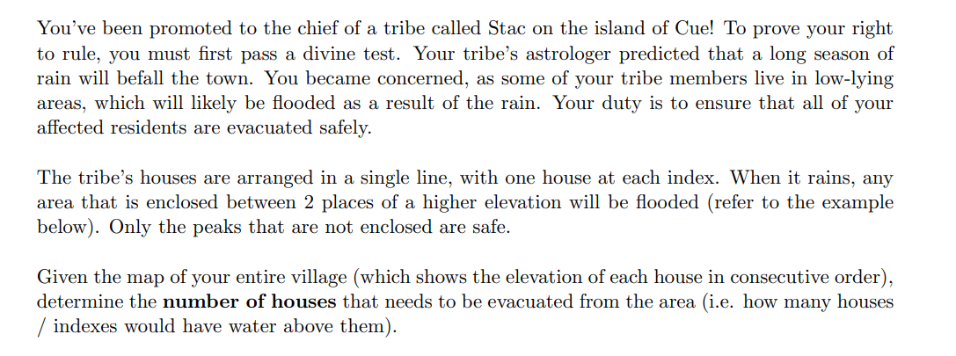
Qn4 Stac and Cue

Slide 47
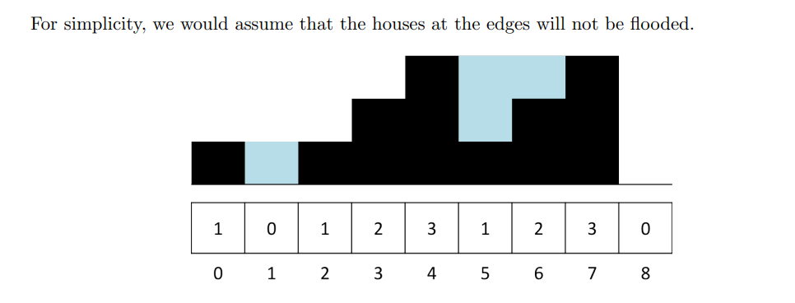

Slide 48
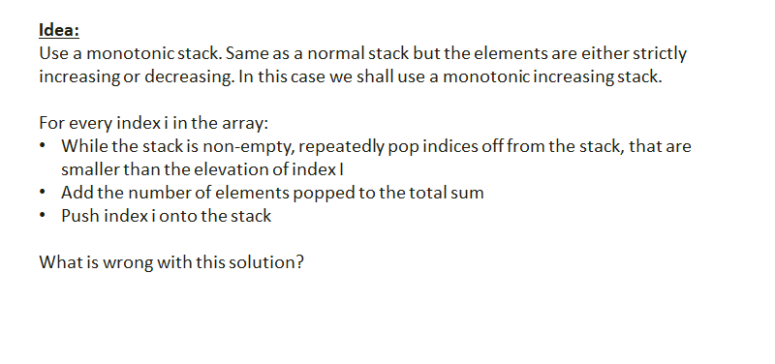
Qn4 Answer
Use a stack!
When open bracket is used -> push to stack
When closed bracket is used -> pop from stack
The string will be valid if stack is empty at the end + there are no pops on empty stack.

Slide 49
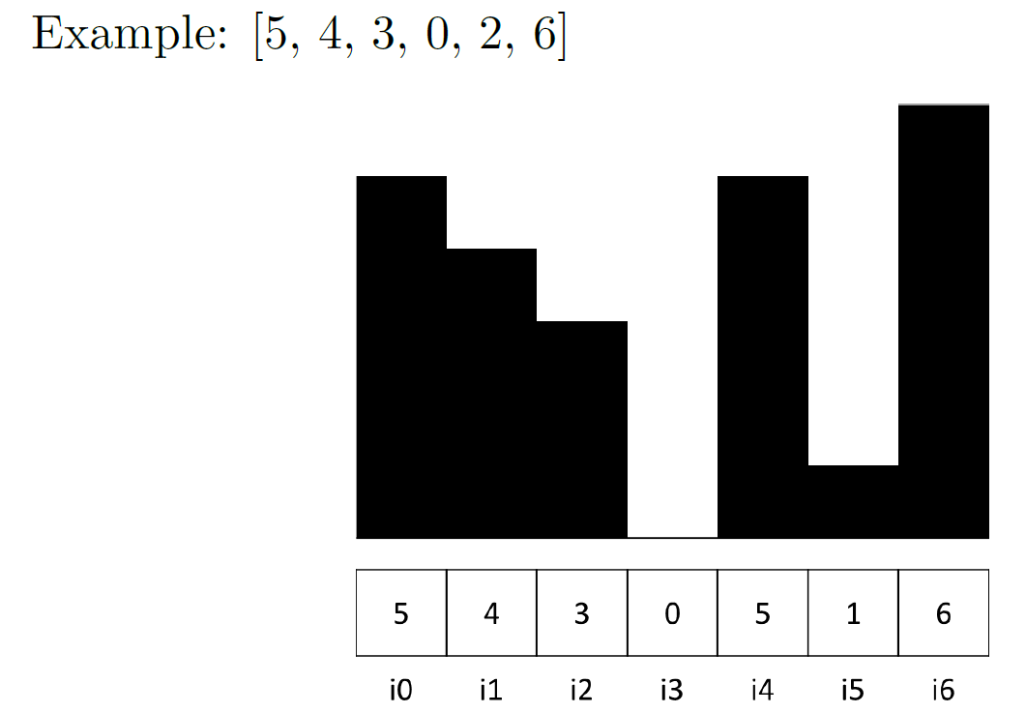
Qn4 Answer
res = 0, stack: {}
i0 -> push to stack
i1 -> push to stack
i2 -> push to stack
i3 -> push to stack
Stack at the moment: {5,4,3,0}

Slide 50
Qn4 Answer
res = 0, stack: {5,4,3,0}
i4 -> 5 is larger then peek(0), pop, res++
res = 1, stack: {5,4,3}
5 > peek(3), pop, res ++
res = 2, stack: {5,4}
5 > peek(4), pop, res ++
res = 3, stack: {5}

Slide 51
Qn4 Answer
res = 3, stack: {5}
push (5), stack: {5, 5}
i5 -> push to stack
i6 -> Same as before pop all 3 from stack.
res = 6, stack : {}
Keep track of max, max_count(number of max values popped)
Max = 5, max_count = 2

Slide 52
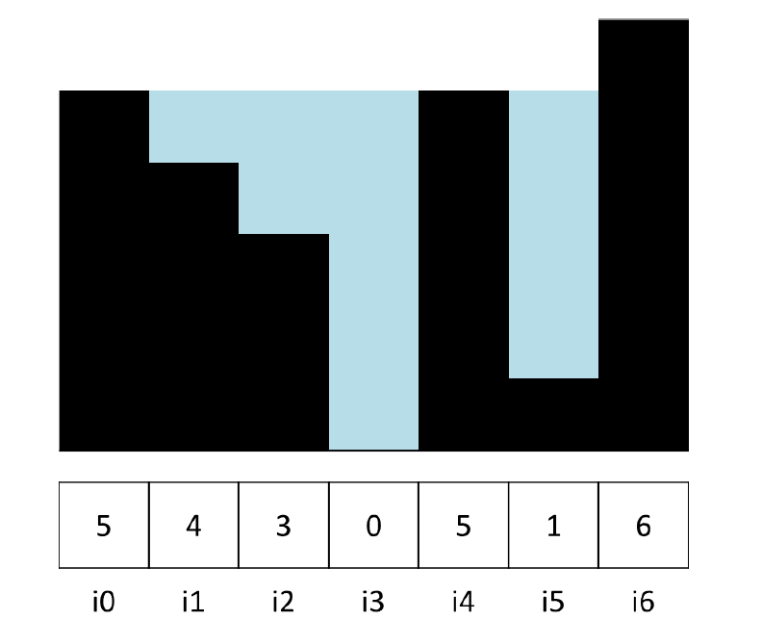
Qn4 Answer
Since stack is now the new max,
Previous max will not be flooded
res -= max_count
push()
res = 4, stack = {6}

Slide 53
Qn5
Sort a queue using another queue with O(1) additional space.

Slide 54
Qn5 Answer
Sort a queue using another queue with O(1) additional space.
Do it like merge sort!

Slide 55
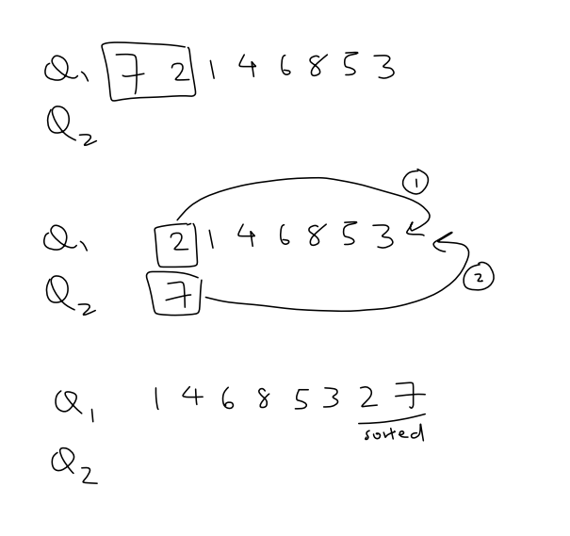
Qn5

Slide 56
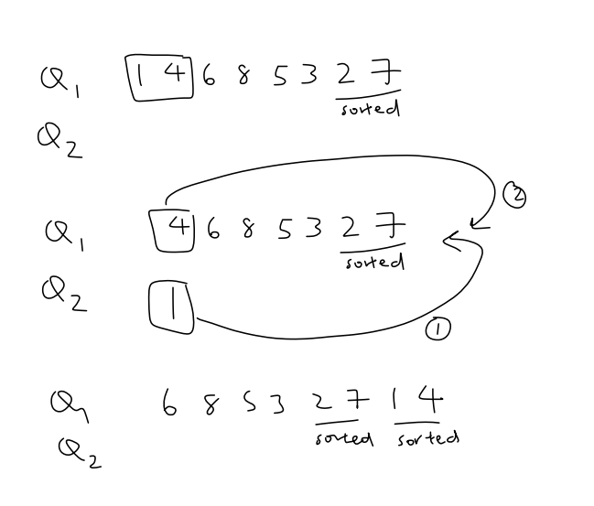
Qn5

Slide 57
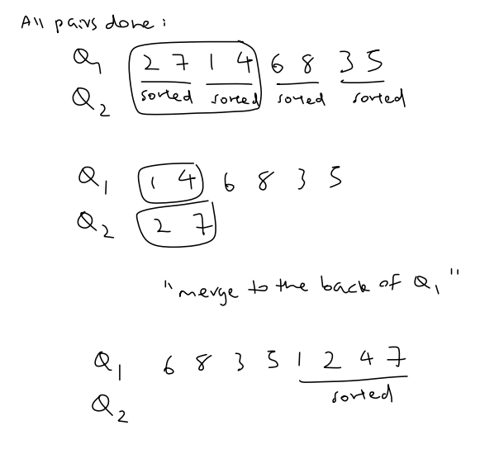
Qn5

Slide 58
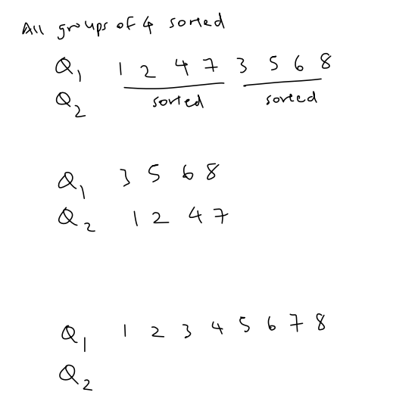
Qn5

Slide 59
Treasure Island
N keys, K correct keys
Try unlocking chest with >= K keys
If all keys are correct in the set, chest Is unlocked
Find the K keys

Slide 60
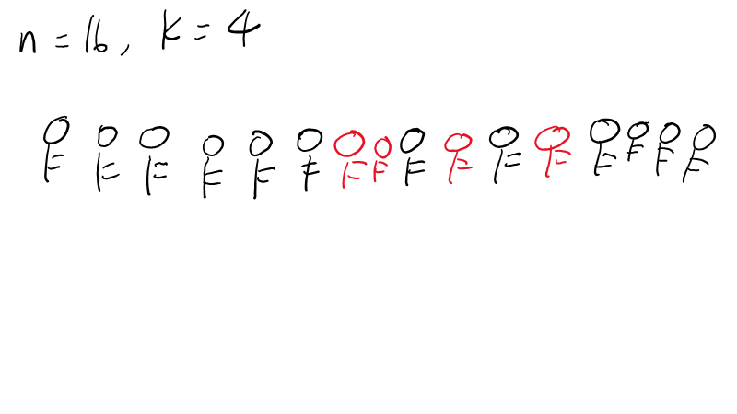

Slide 61
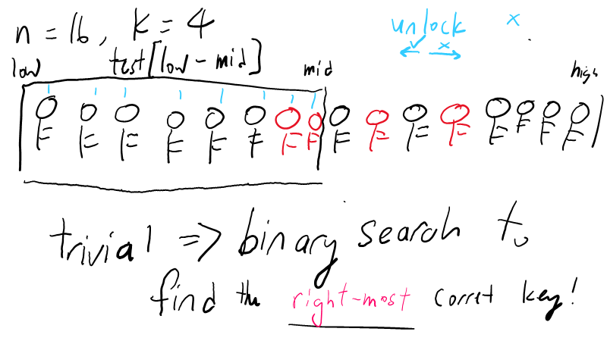

Slide 62
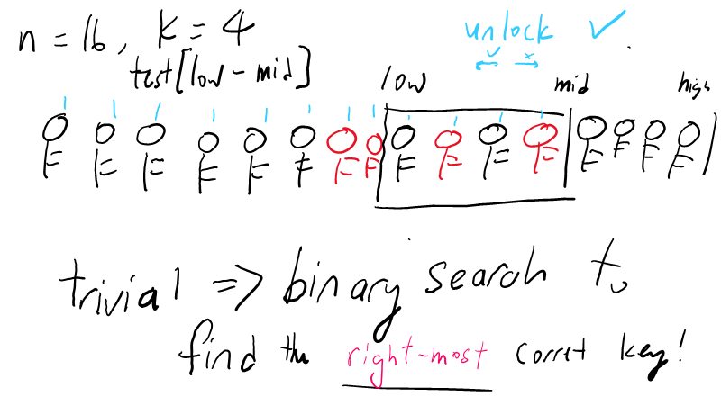

Slide 63
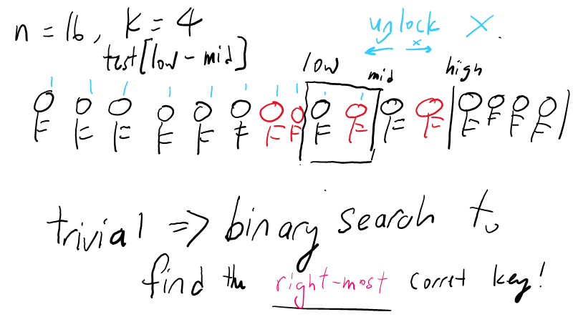

Slide 64
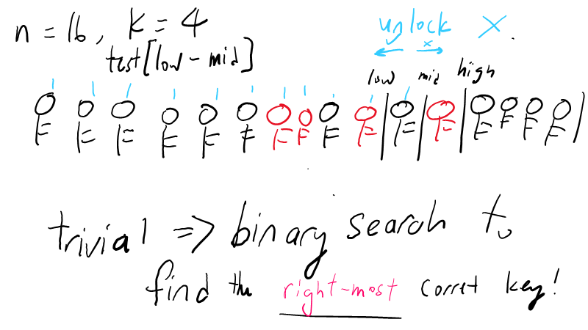

Slide 65
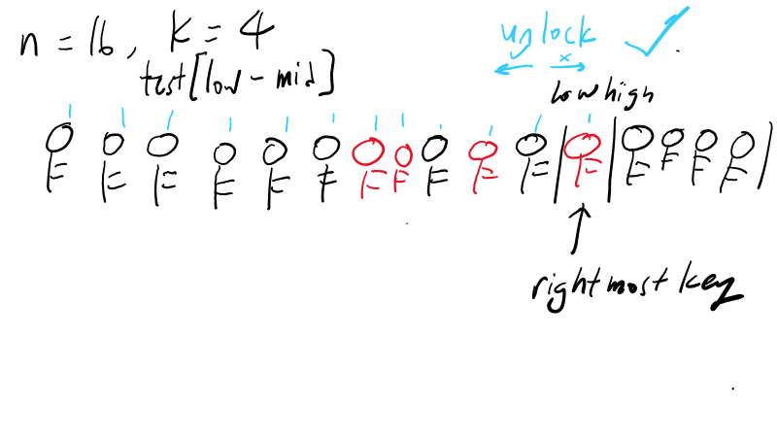

Slide 66
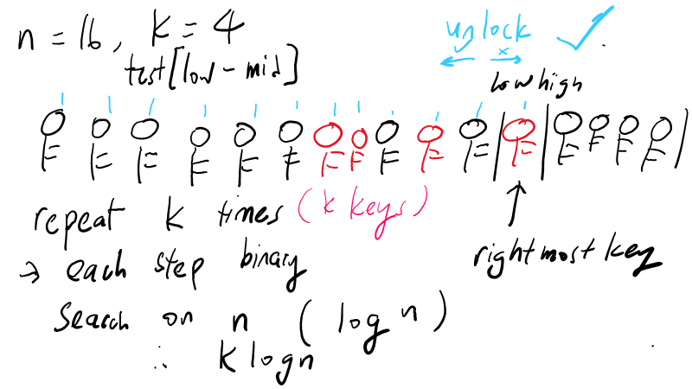

Slide 67
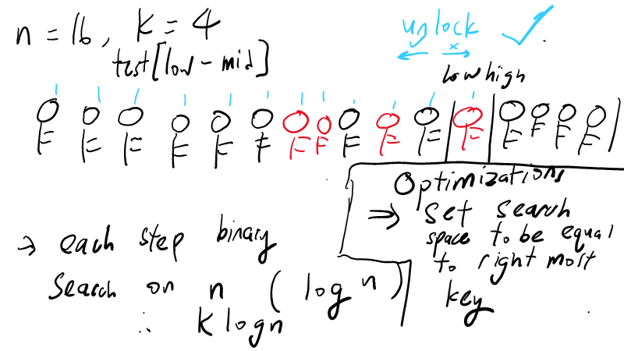

Slide 68
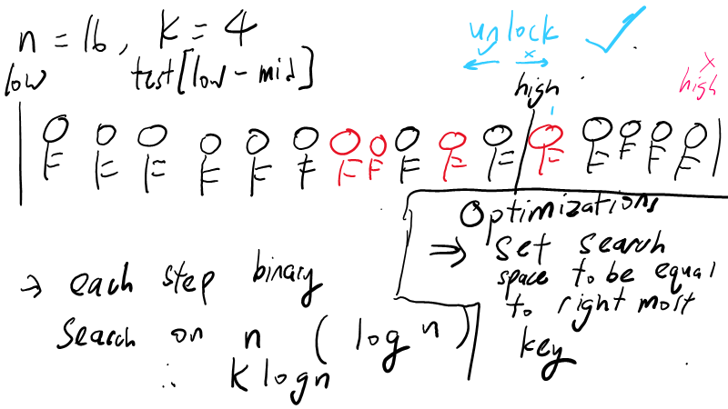

Slide 69
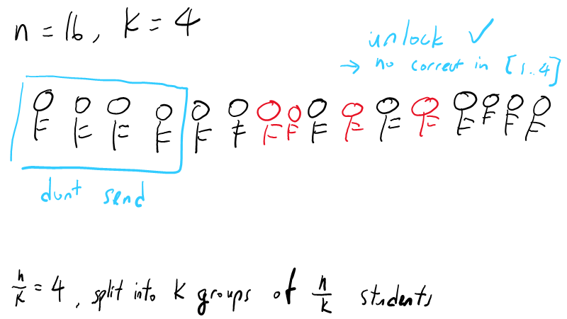

Slide 70
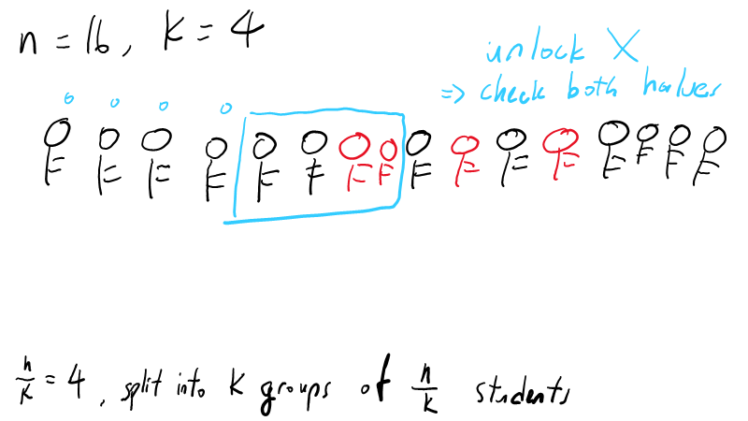

Slide 71
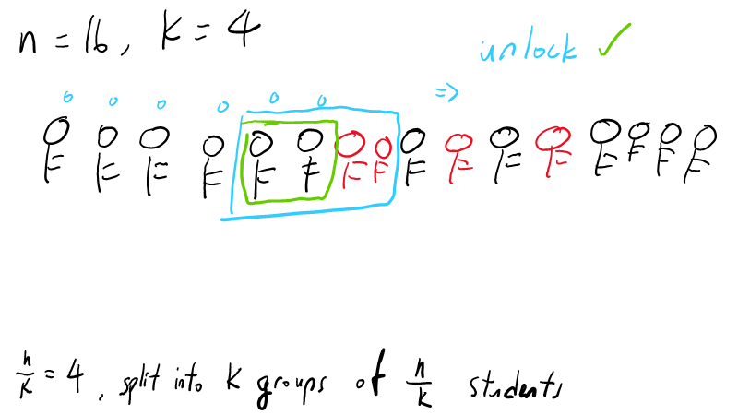

Slide 72
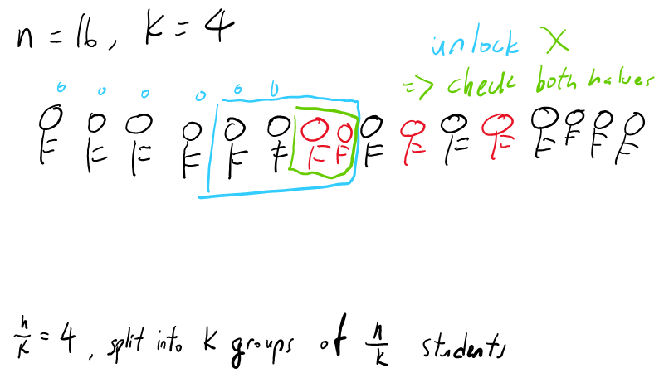

Slide 73
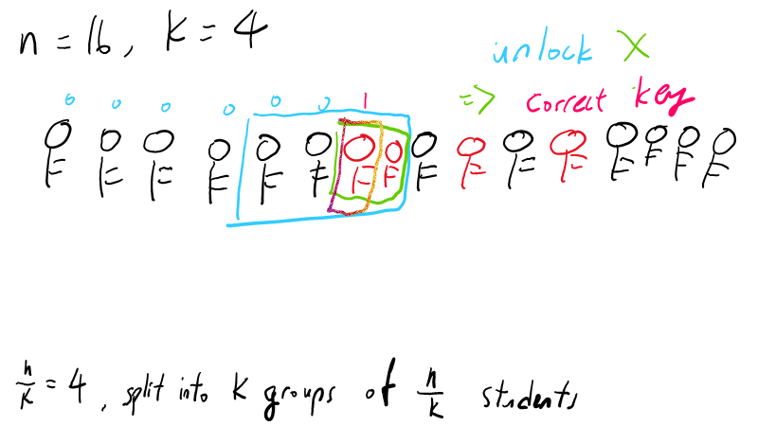

Slide 75
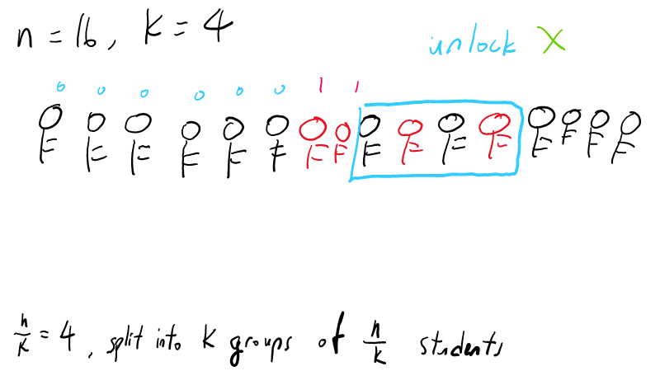

Slide 76
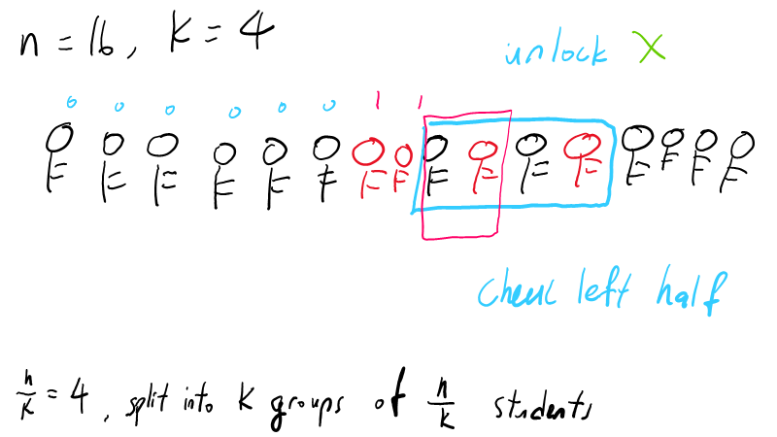

Slide 77
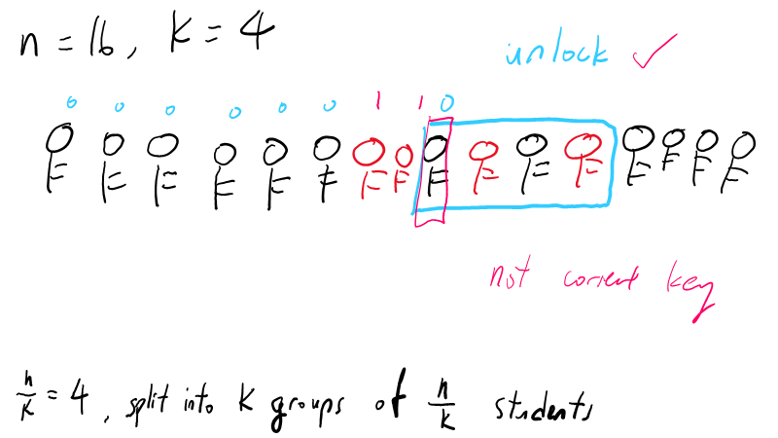

Slide 78
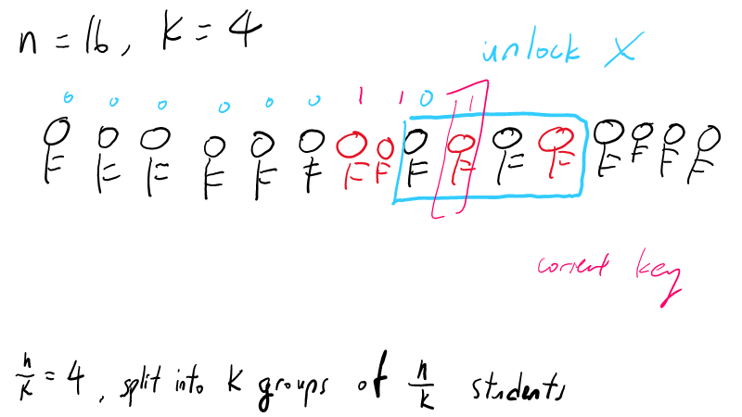

Slide 79
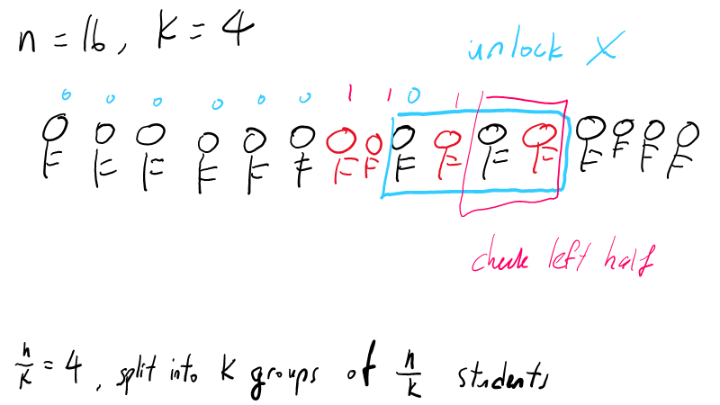

Slide 80
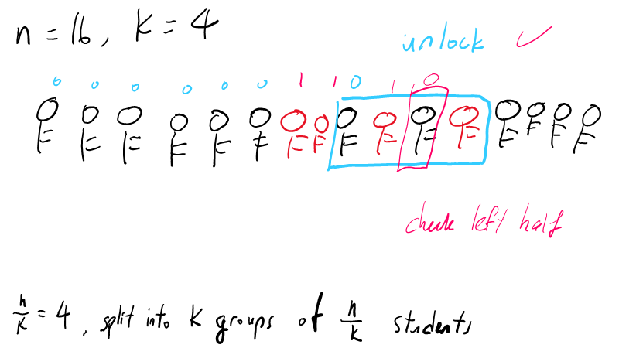

Slide 81
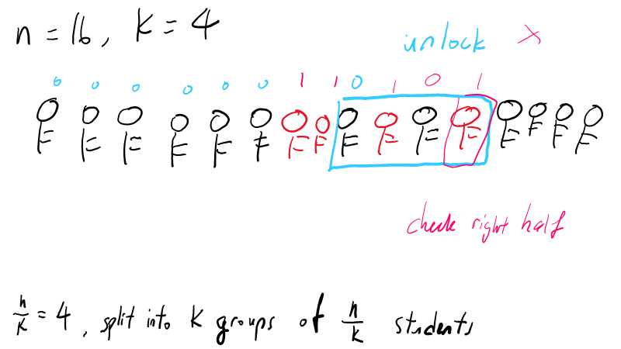

Slide 82
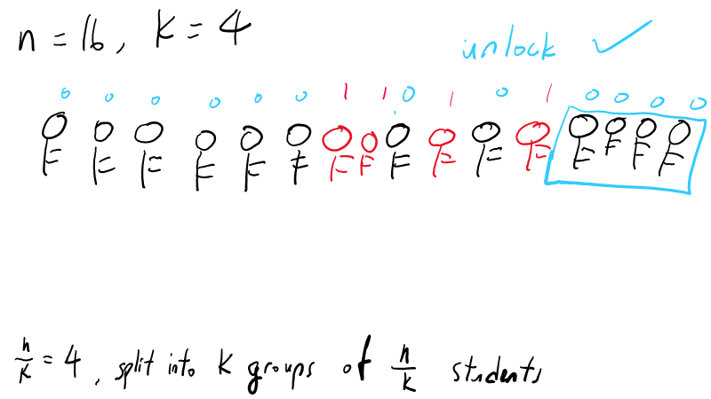

Slide 83


